Slide 1
INTERVIEW PRESENTATION
Maha Montassar

Slide 2
Machine Learning Algorithms

Slide 3
I. MACHINE LEARNING ALGORITHMS
Machine Learning
Supervised
Unsupervised
Reinforcement
Regression
Clustering
Linear
Polynomial
SVD
PCA
K-means
Continuous
Decision Tree
Random Forest
Classification
Hidden Markov Model
Categorical
KNN
Logistic regression
SVM
Naïve-Bayes

Slide 4
II. DECISION TREE
One of the most popular machine learning algorithms. It uses a tree like structure and their possible combinations to solve a particular problem, it can be used for classification, regression and Feature Selection purposes. Decision tree consists of:
Nodes representing decisions or tests on attributes
Branches representing the outcome of these decisions
Leaf nodes representing final outcomes or predictions

Slide 5
The process of creating a decision tree involves:
Selecting the Best Attribute: Using a metric like Gini impurity, entropy, or information gain, the best attribute to split the data is selected.
Splitting the Dataset: The dataset is split into subsets based on the selected attribute.
Repeating the Process: The process is repeated recursively for each subset, creating a new internal node or leaf node until a stopping criterion is me.

Slide 6
Applications:
Business Decision Making: Used in strategic planning and resource allocation.
Healthcare: Assists in diagnosing diseases and suggesting treatment plans.
Finance: Helps in credit scoring and risk assessment.
Marketing: Used to segment customers and predict customer behavior.
Limitations:
The biggest issue of decision trees in machine learning is overfitting, which can lead to wrong decisions. A decision tree will keep generating new nodes to fit the data. This makes it complex to interpret, and it loses its generalization capabilities. It performs well on the training data, but starts making mistakes on unseen data.
The addition of new data points leads to the re-generation of the overall tree meaning that nodes need to be recalculated.

Slide 7
III. K-MEANS
K-means is often referred to as Lloyd’s algorithm. It is one of the most popular algorithms for partitioning a data set into K distinct, non-overlapping clusters. The K-means algorithm clusters data by trying to separate samples in n groups of equal variance.

Slide 8
Step1
Step 2
Determine the value of K
Centroid initialization
Step 3
Measure the distance
Step6
Step 4
Not convergence
Not max number of iteration
Assign the nearest cluster
Step 8
Step 5
New centroid initialization
Repeat until the lowest sum of variance
Step 7
Convergence
Max number of iteration
Clustering result
Measure the variance
Get the lowest sum of variance

Slide 9
Applications:
Customer Segmentation: group customers and identify them for or personalized marketing campaigns and product recommendations.
Document Clustering and Text Mining: clustering documents into groups based on their content to identify underlying topics.
Anomaly detection: helps in fraud detection and detecting anomalies in network traffic.
Limitations:
Sensitivity to Initialization: The algorithm’s results can vary based on the initial placement of centroids, leading to suboptimal solutions.
Outlier Sensitivity: K-Means can be sensitive to outliers, as they can disproportionately influence the position of centroids.

Slide 10
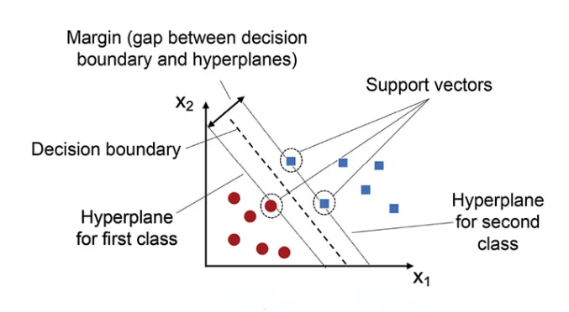
IV. SUPPORT VECTOR MACHINE
A widely used machine learning algorithm that can be used for classification, regression, and outlier detection. It is known for its ability to find the optimal decision boundary between different classes by maximizing the margin between them.

Slide 11
Key terms:
Hyperplane: a decision boundary that separates data points into different classes in a high-dimensional space. In two-dimensional space, a hyperplane is simply a line that separates the data points into two classes. In N-dimensional space, a hyperplane has (N-1)-dimensions.
Margin: the distance between the decision boundary (hyperplane) and the closest data points from each class. The goal of SVMs is to maximize this margin while minimizing classification errors.
Support Vectors: they are the data points that lie closest to the decision boundary. These data points are important because they determine the position and orientation of the hyperplane, and thus have a significant impact on the classification accuracy of the SVM

Slide 12
Applications:
Text Classification and Natural Language Processing: used in spam detection, sentiment analysis and document categorization.
Image Recognition and Computer Vision: helps in object detection, face recognition and handwriting recognition.
Healthcare and Medicine: assists in Disease Diagnosis and Predictive Health Analytics.
Limitations:
Not suitable for large datasets with many features: SVMs can be very slow and can consume a lot of memory when the dataset has many features.
Not suitable for datasets with missing values: SVMs requires complete datasets, with no missing values, it can not handle missing values.

Slide 13
Data Cleaning and Preprocessing

Slide 14
Real-world data can have errors, outliers and missing values since it comes from a variety of resources. Data cleaning is the process of identifying and correcting errors and inconstancies in data to improve its quality.
the best practices of data cleaning consist of:
Data understanding
Data cleaning
Data Splitting
Data transformation
Feature selection

Slide 15
I. Data Understanding
This step is crucial before start cleaning the data, it consists of understanding the data variable and involves gaining insight into the structure, quality, and characteristics of the data before any analysis or modeling takes place.

Slide 16
II. DATA CLEANING
Also known as data cleansing, is the process of detecting and correcting corrupt or inaccurate records from a dataset. It consists of:
Missing values handling: Dealing with missing data by either removing records with missing values, filling them in with appropriate values (such as the mean or median), or using other imputation techniques
Removing duplicates: Identify and remove duplicate records.
Outliers handling: Outliers are a source of data skewness, detecting outliers is a fundamental step in data preprocessing, we can detect them using Visualization techniques such as Interquartile Range and scatter plots or using statistical test such as Standard Deviation and Z_Score. when outliers are detected we can remove them or apply transformation on data such as Box_Cox or log transformation to reduce the impact.

Slide 17
III. DATA SPLITTING
This step involves dividing the dataset into separate subsets for different purposes, primarily to train and evaluate the model effectively.
Train-Validation-Test Split: Split the data into training, validation, and test sets to ensure unbiased model evaluation.
-Training Set: Used to train the model.
-Validation Set: Used for model tuning and hyperparameter optimization.
-Test Set: Used for final model evaluation to assess its performance on unseen data.

Slide 18
IV. DATA TRANSFORMATION
A crucial step, It involves converting raw data into a format that is suitable for analysis and modeling. This step includes:
Feature Engineering: Create new features from existing ones to better represent the underlying problem.
Encoding Categorical Variables: Convert categorical variables into numerical values using techniques like one-hot encoding, label encoding, or target encoding.
Data Normalization & Standardization: Depending on the algorithm we are using, we may need to normalize or standardize the feature so that they contribute equally to the model's performance

Slide 19
V. FEATURE SELECTION
Feature selection is a crucial step in data preprocessing that helps in identifying the most relevant features for training your model
Filter-based
Wrapper-based
Embedded
Select subset of features based on their relationship with the target:
Information Gain
Chi-square test
Fisher’s score
Search for well performing subset of features using a machine learning algorithm:
Forward selection
Backward selection
Stepwise selection
Include the feature selection process during the model training:
Regularization
Random Forest Importance

Slide 20
Model Evaluation Metrics

Slide 21
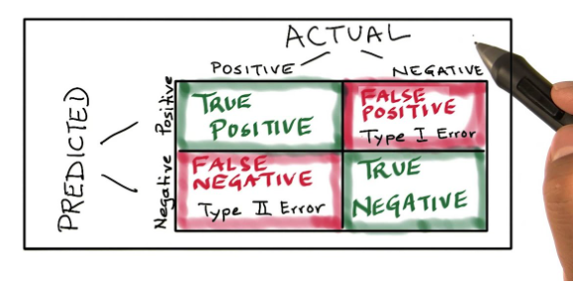
Evaluating a machine learning model is an important step to understand it's effectiveness. Evaluation metrics depend on the type of the problem: classification and regression.
Classification metrics:
Confusion matrix : a table used to describe the performance of a classification model on a set of test data for which the true values are known

Slide 22
Accuracy: represents the number of correct predictions made by the model over all kinds predictions made.
Precision: is defined as the number of true positives divided by the number of true positives plus the number of false positives.
F1 score: The harmonic mean of precision and recall.
ROC-AUC: Measures the area under the ROC curve which plots the true positive rate against the false positive rate.
Logarithmic Loss : Log loss measures the performance of a classification model where the prediction input is a probability value between 0 and 1.

Slide 23
Regression metrics:
Mean Absolute Error (MAE): The average of the absolute differences between predicted and actual values.
Mean Squared Error (MSE): The average of the squared differences between predicted and actual values.
Root Mean Squared Error (RMSE): The square root of the mean squared error.
R-squared: Indicates the proportion of the variance in the dependent variable that can be explained by the independent variables in the regression mode.
Adjusted R-squared: Adjusts the R-squared value based on the number of predictors in the model.

Slide 24
When to Use Each Metric:
-Balanced Datasets: Accuracy, ROC-AUC.
-Imbalanced Datasets: Precision, Recall, F1 Score, Confusion Matrix.
-Probability Predictions: Log Loss, ROC-AUC.
-Regression: MAE, MSE, RMSE, R², Adjusted R².
-Comparing Models: ROC-AUC for classifiers, Adjusted R² for regression.

Slide 25
Model Validation Techniques

Slide 26
Model validation assesses the ability of ML model to produce predictions with enough accuracy to be used to achieve business objectives. It helps ensure that the model performs as intended and can handle unseen data.
Based on the data how is used in training, model validation can be categorized into two main approaches:
In sample validation: This approach involves the use of data from the same dataset that was employed to develop the model.
Holdout method: The dataset is then divided into training set which is used to train the model and a hold out set which is used to test the performance of the model.

Slide 27
Out-of-Sample Validation: This approach relies on entirely different data from the data used for training the model. This gives a more reliable prediction of how accurate the model will be in predicting new inputs.
K-Fold Cross-validation: The data is divided into k number of folds. The model is trained on k-1 folds and tested on the fold that is left. This is repeated k times, each time using a different fold for testing.
Leave-One-Out Cross-validation: This is a form of k-fold cross validation where k is equal to the number of instances. Only one piece of data is not used to train the model. This is repeated for each data point.
Stratified K-Fold Cross-validation: in this type of cross-validation each fold has the same ratio of classes/categories as the overall dataset. This is useful especially where data in one class is very low compared to others.

